Slide 1
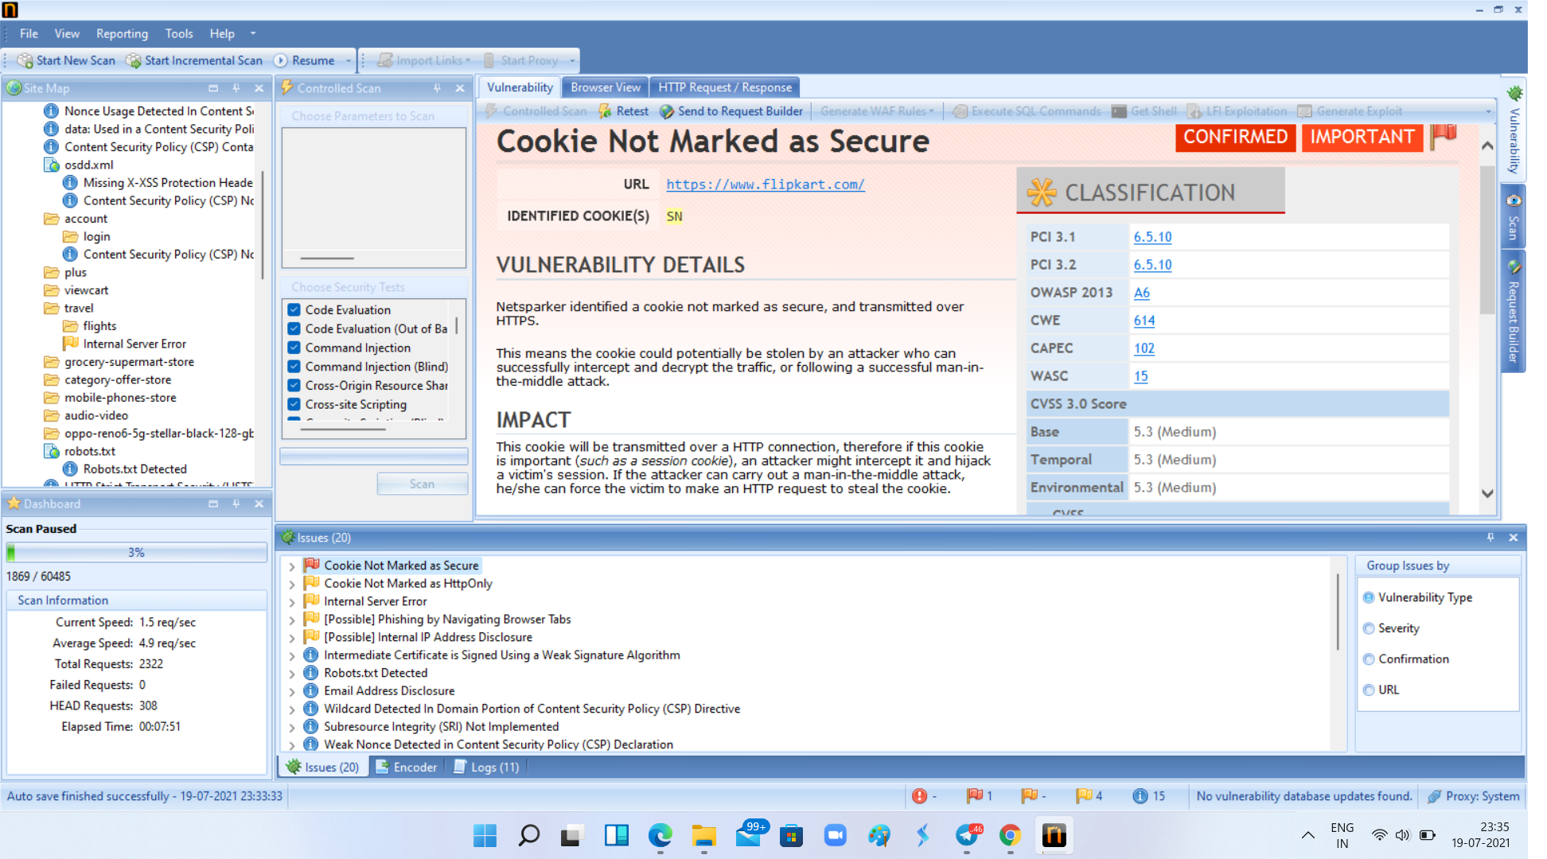
Task 2
Found Vulnerability

Slide 2
Report
Title: Cross Site Scripting
Domain: flipkart.com
Software: Netsparker
Vulnerability name: cookie not marked as secure
Impact: By this an attacker can stole important data of customer using man in the middle attack.

